Slide 1


Kanak print-n-pack
C

Slide 2
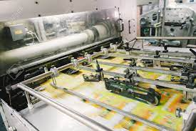
C
About us
Established in the year 1997, we “Kanak Print-N-Pack ” is one of the Leading Manufacturer and Dealer of a wide range of Paper, PVC & PP Products used in the packaging and value addition for your products
We are engaged in manufacturing, supplying, wholesaler, distributer, trading a wide assortment.
Printed Satin
Ribbon Roll
Rubber Silicon Label and Taffeta Labels
Printed Stickers, Paper Sticker.
Packaging like Clear PVC Bag, Soft PVC Pouches
Stitched Pvc bags
Thermocol sheets
Packaging Boxes
Rubber tags & Rubber keychain
Our valued clients can avail these products from us at reasonable rates. Ably led by “Mr. Mahendra Mehta” to outshine all competitors in all aspects.We have gained a remarkable and strong position in the market.

Slide 3
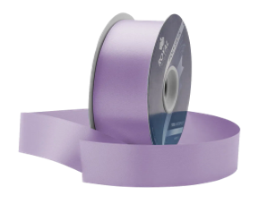
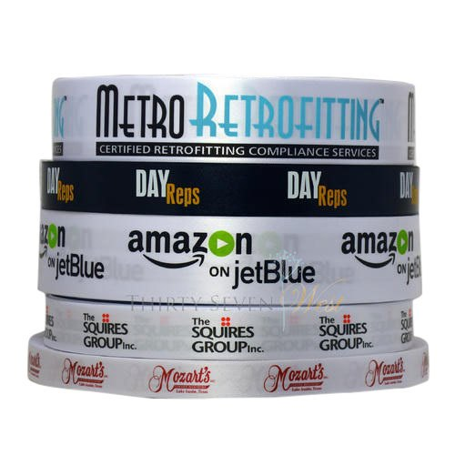
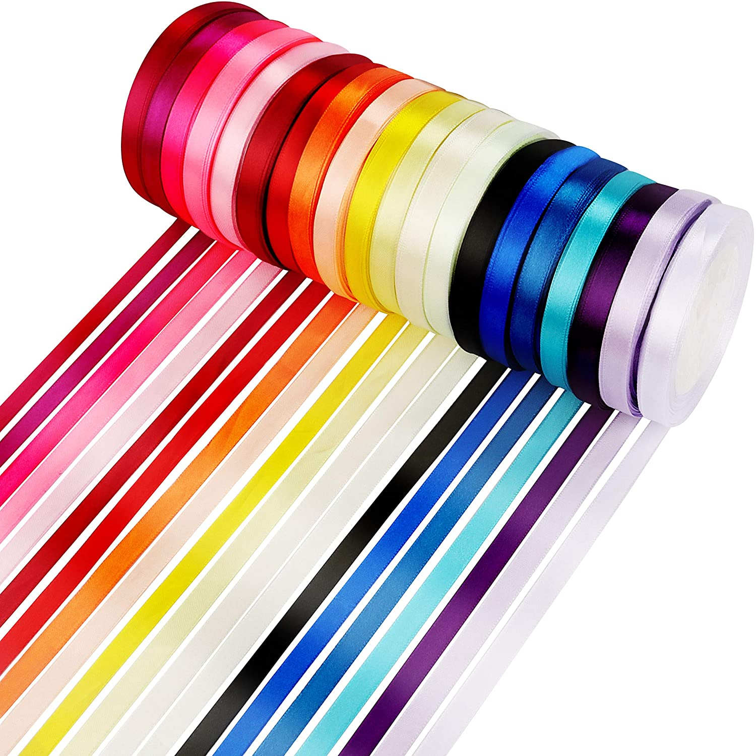
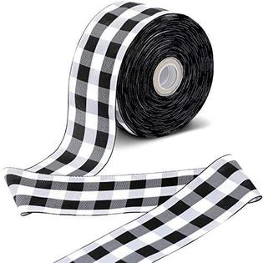
C
RIBBON
Satin Ribbon and Taffeta Ribbon used in textile industry, garment industry, gift articles,branding awareness, hosiery industry, textile fabric industry. We produce a wide variety of ribbons which are perfect for
Festival decorations
Floral designs
apparel accessories
crafts & gifts
Cosmetics
food packaging and many more.
Satin Ribbon
Taffeta Ribbon

Slide 4



C
Contact Us
Office : 9/11,Ladwadi,Shakti Sadan,3rd Floor, R N 20,Old Hanuman Lane,Kalbadevi Road, Nr Old Hanuman Lane, Mumbai-400002.
Mahendra Mehta 9322299267
Vastupal Mehta
9029031502
Works: Unit No 106, 1st Floor, building no A6, Prerna Complex,Dapoda Road, Val Village, Bhiwandi 421302, Thane.
kanakprints1@gmail.com

